Slide 1
4장 JOIN을 배웁니다
1. Cartesian Product(카티션 곱)
2. EQUI Join(등가 조인)
3. Non-Equi Join(비등가 조인)
4. Outer Join
5. Self Join
[ 이번 장에서 배울 내용들 ]
Join 의 개념을 배웁니다
2. 다양한 join 의 기법들을 Oracle join 과 ANSI join 문법으로 배웁니다.
.

Slide 2
[[ sw시스템 종류 ]]
⚆ (네트워크x) 단독 시스템 : 메모장, 그림판, 엑셀, 워드, PPT .....
⚆ (네트워크o) ㅇㅇ정보[제공/관리]시스템:
Client
DB Server
JDK
-앱 [CS프로그램]
SQLplus
SQLdeveloper
cmd
Eclipse
VS
Internet
id/pass
DBMS
[a.sql]
SQL
[b.java]
Java+SQL
[c.vbp]
VB+SQL
학교, 병원,회사, ...
프로세스
모델링
데이터
모델링
DB
SQL, PL/SQL
-웹 [Web CS프로그램]
WebClient
Web Container(tomcat)
[WB]
Chrome
IE
Internet
http://ip/a.jsp
Internet
id/pass
DB Server
[WS] 정적문서
Apache, IIS
[WAS] 동적문서
WebLogic,Jeus
DBMS
HTML
css
JS
(Vue.js)
JDK+tomcat
학교, 병원,회사, ...
[a.html]
HTML
[b.jpg]
이미지
Eclipse
[c.jsp]
JSP+SQL
프로세스
모델링
데이터
모델링
DB
cmd
Python+(Django)
(Spring)
SQL, PL/SQL

Slide 3
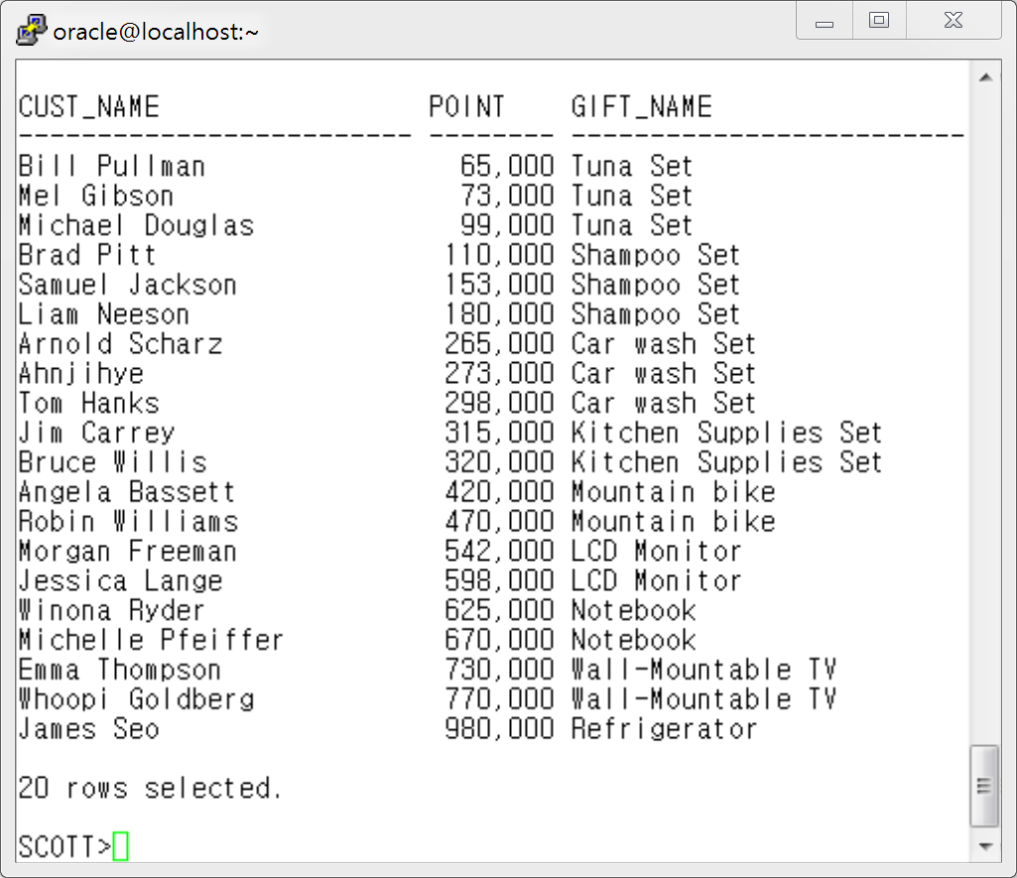
3. Non-Equi Join (비등가 Join)
예 1) Custormer 테이블과 gift 테이블을 Join하여 고객별로 마일리지 포인트를 조회한 후 해당 마일리지 점수로 받을 수 있는 상품을 조회하여 고객의 이름과 받을 수 있는 상품 명을 아래와 같이 출력하세요.

Slide 4
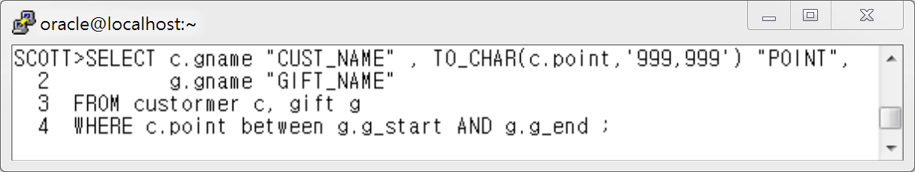
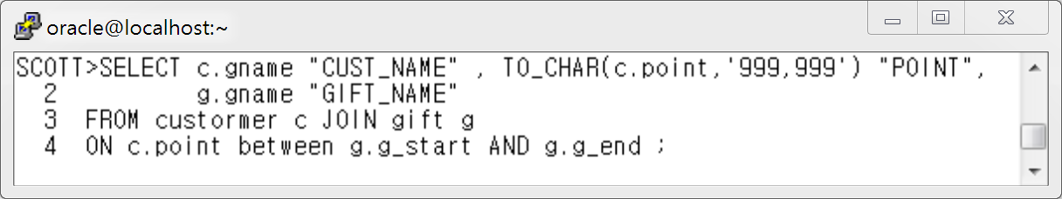
[ Oracle Join 구문 ]
[ ANSI Join 구문 ]
Between 대신 다음 페이지 예제처럼 작성하세요~

Slide 5
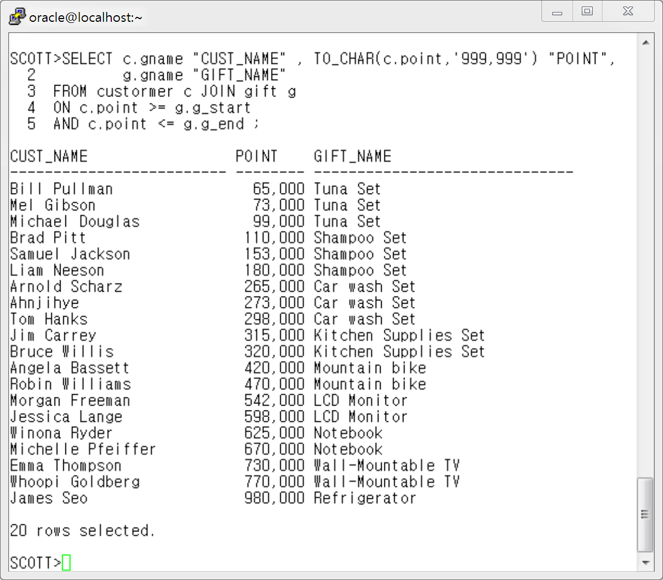

Slide 6
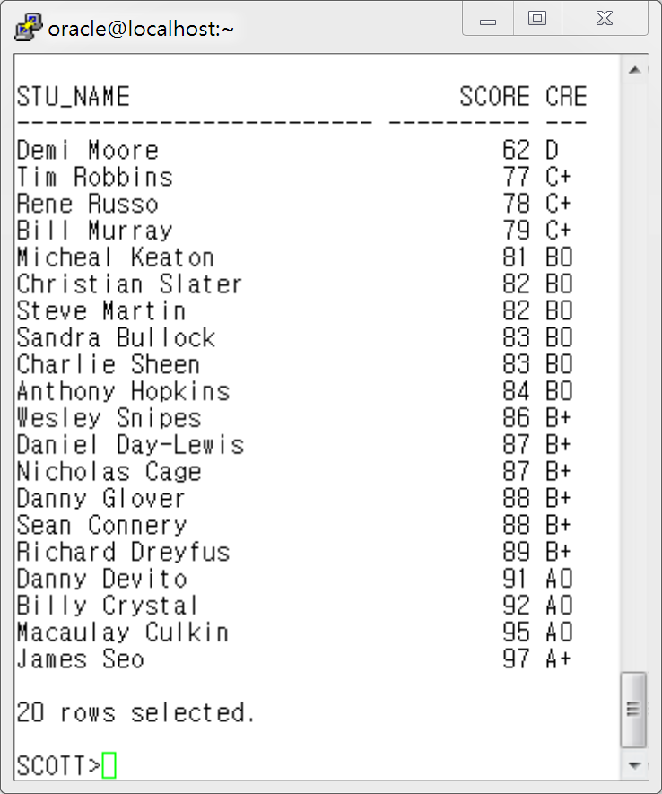
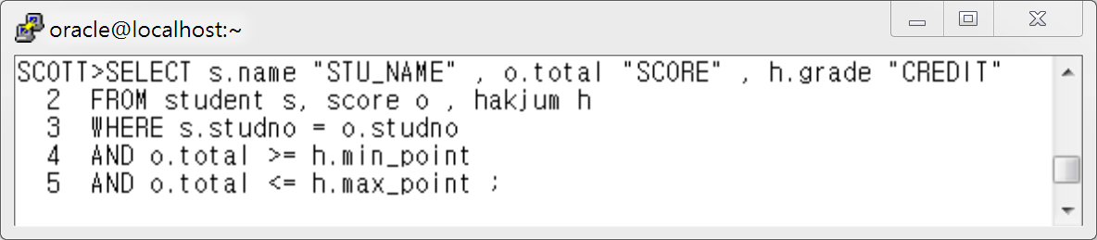
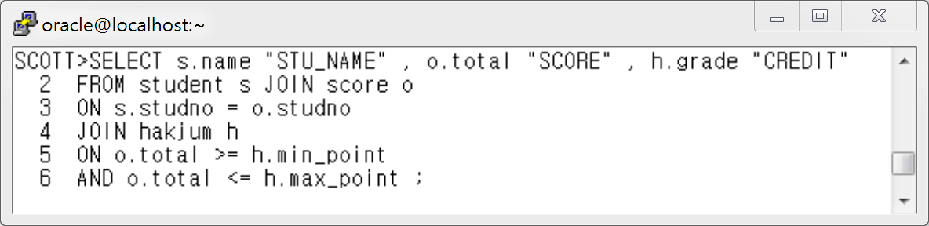
예 2) Student 테이블과 score 테이블 , hakjum 테이블을 조회하여 학생들의
이름과 점수와 학점을 출력하세요.
[ Oracle Join 구문 ]
[ ANSI Join 구문 ]

Slide 7
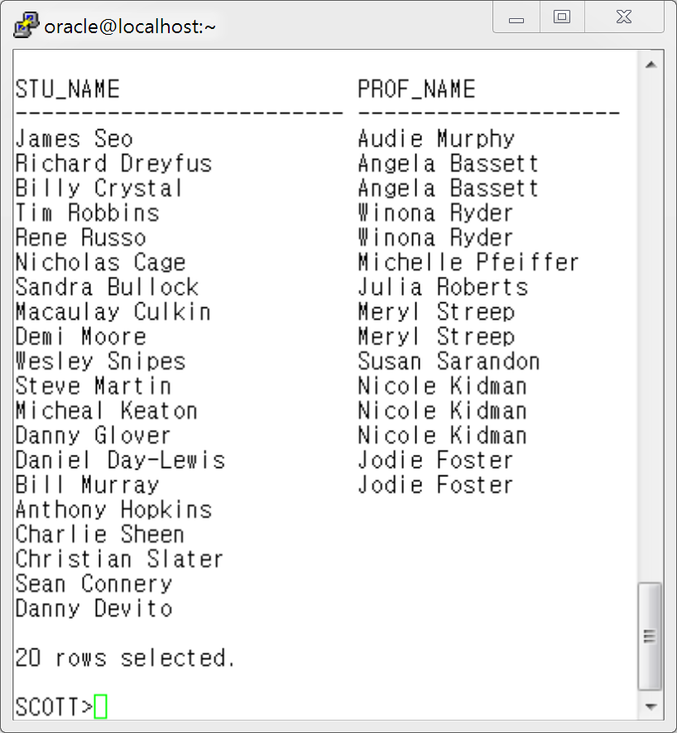
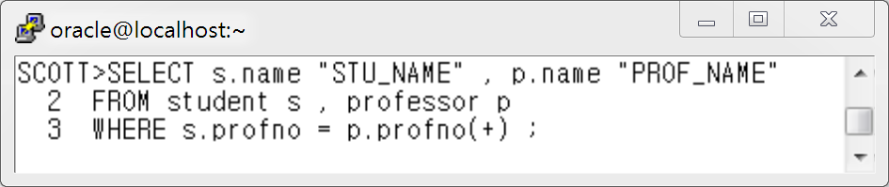
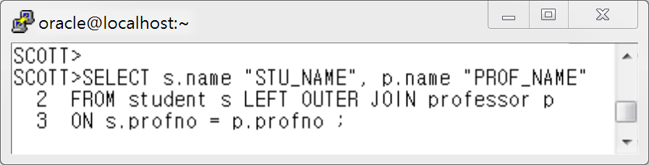
4. OUTER Join (아우터 조인) vs INNER Join ( 이너 조인 )
예 1 ) Student 테이블과 Professor 테이블을 Join하여 학생이름과 지도교수 이름을 출력하세요.
단 지도교수가 결정되지 않은 학생의 명단도 함께 출력하세요.
[ Oracle Outer Join 문법 ]
[ ANSI Outer Join 문법 ]

Slide 8
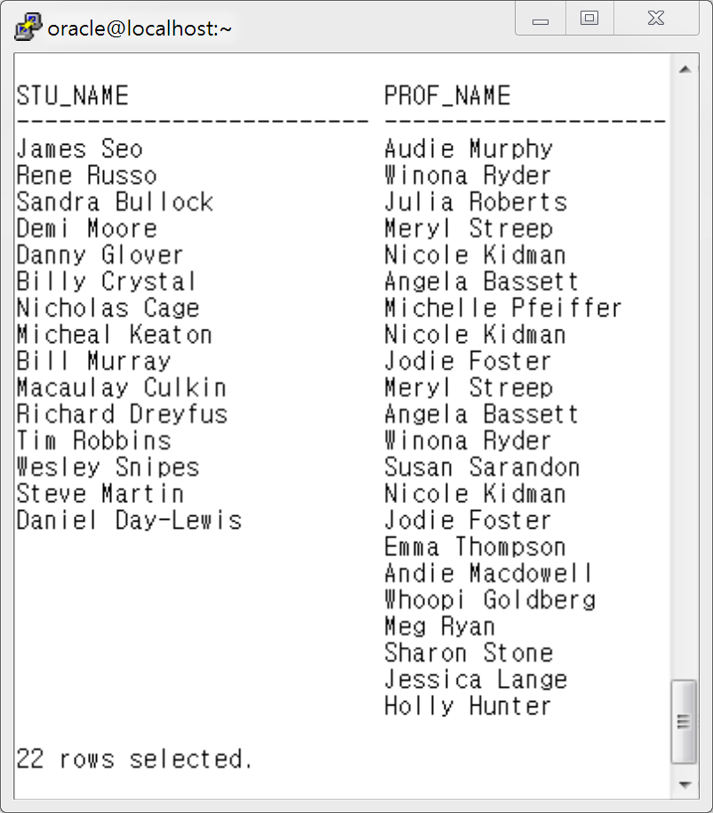
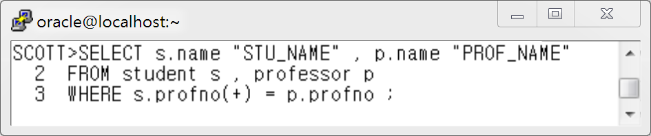
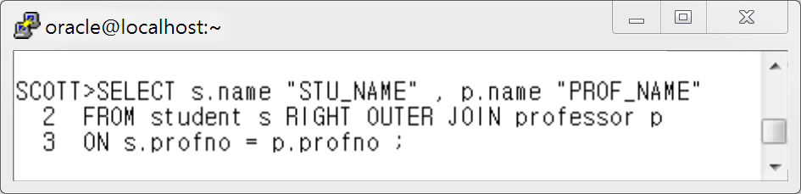
예 2 ) Student 테이블과 Professor 테이블을 Join하여 학생이름과 지도교수 이름을 출력하세요.
단 지도학생이 결정되지 않은 교수의 명단도 함께 출력하세
[ Oracle Outer Join 문법 ]
[ ANSI Outer Join 문법 ]

Slide 9
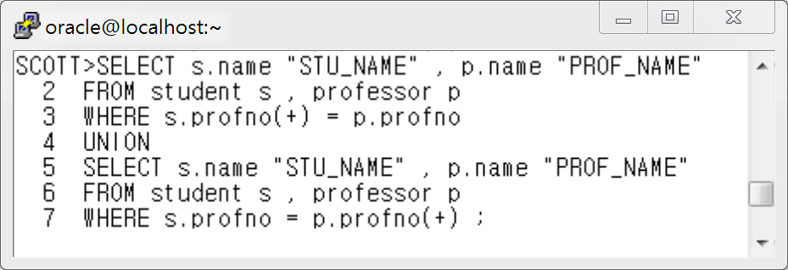
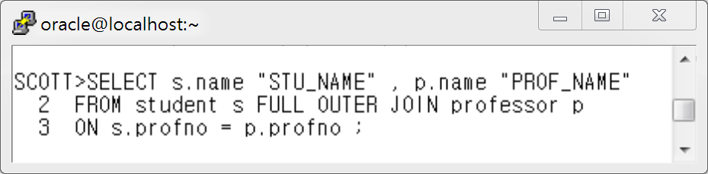
예 3 ) Student 테이블과 Professor 테이블을 Join하여 학생이름과 지도교수 이름을 출력하세요.
단 지도학생이 결정 안 된 교수 명단과 지도 교수가 결정 안된 학생 명단을 한꺼번에 출력하세요.
Oracle Outer Join 문법
ANSI Full Outer Join 문법

Slide 10
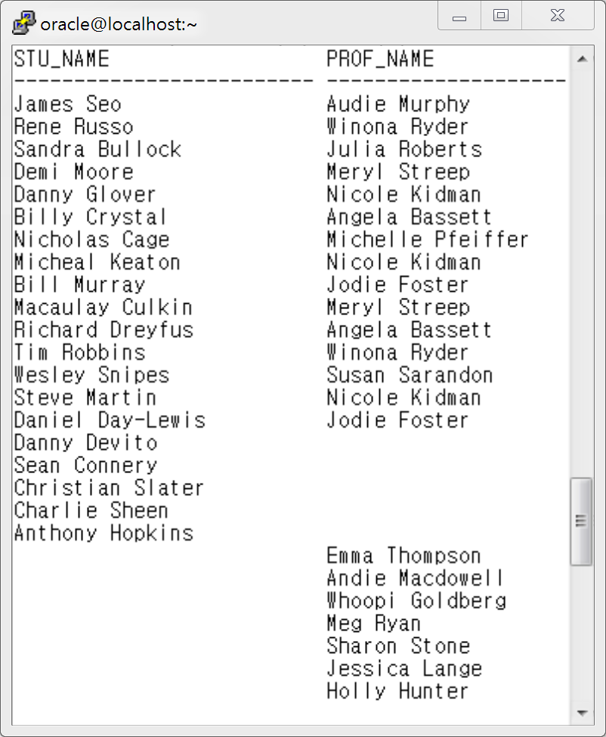
지도 교수가 없는 학생들을 출력한 결과임
지도 학생이 없는 교수들을 출력한 결과임

Slide 11
Oracle Outer Join 테이블 준비:
EMPNO ENAME JOB MGR HIREDATE SAL COMM DEPTNO
----- --------- --------- ----- -------- ----- ----- -------
7369 SMITH CLERK 7902 80/11/17 800 20
7499 ALLEN SALESMAN 7698 81/02/20 1600 300 30
7521 WARD SALESMAN 7698 81/02/22 1250 500 30
7566 JONES MANAGER 7839 81/04/02 2975 20
7654 MARTIN SALESMAN 7698 81/09/28 1250 1400 30
7698 BLAKE MANAGER 7839 81/05/01 2850 30
7782 CLARK MANAGER 7839 81/06/09 2450 10
7788 SCOTT ANALYST 7566 82/12/09 3000 20
7839 KING PRESIDENT 81/11/17 5000 10
7844 TURNER SALESMAN 7698 81/09/08 1500 0 30
7876 ADAMS CLERK 7788 83/01/12 1100 20
7900 JAMES CLERK 7698 81/12/03 950 30
7902 FORD ANALYST 7566 81/12/03 3000 20
7934 MILLER CLERK 7782 82/01/23 1300 10
14 개의 행이 선택되었습니다.
select * from dept;
DEPTNO DNAME LOC
------- ---------- ---------
10 ACCOUNTING NEW YORK
20 RESEARCH DALLAS
30 SALES CHICAGO
40 OPERATIONS BOSTON

Slide 12
Oracle Outer Join 주의사항(1)
부서에 대한 정보를 모두 보여주고,
부서번호가 20인 사원의 사원번호, 이름, 급여를 구하시오.
select d.deptno, d.dname, d.loc, e.empno, e.ename, e.sal
from dept d, emp e
where d.deptno = e.deptno(+) and e.deptno =20
order by 1;
DEPTNO DNAME LOC EMPNO ENAME SAL
------- ---------- --------- ----- --------- -----
20 RESEARCH DALLAS 7369 SMITH 800
20 RESEARCH DALLAS 7566 JONES 2975
20 RESEARCH DALLAS 7788 SCOTT 3000
20 RESEARCH DALLAS 7876 ADAMS 1100
20 RESEARCH DALLAS 7902 FORD 3000
select d.deptno, d.dname, d.loc, e.empno, e.ename, e.sal
from dept d, emp e
where d.deptno = e.deptno(+) and e.deptno(+) =20
order by 1;
DEPTNO DNAME LOC EMPNO ENAME SAL
------- ---------- --------- ----- --------- -----
10 ACCOUNTING NEW YORK
20 RESEARCH DALLAS 7566 JONES 2975
20 RESEARCH DALLAS 7788 SCOTT 3000
20 RESEARCH DALLAS 7902 FORD 3000
20 RESEARCH DALLAS 7369 SMITH 800
20 RESEARCH DALLAS 7876 ADAMS 1100
30 SALES CHICAGO
40 OPERATIONS BOSTON

Slide 13
Oracle Outer Join 주의사항(2)
직업이 'CLERK'인 사원정보(사원번호, 이름, 직업)을 출력하고,
그중에 'CHICAGO'에 우치한 부서에 소속된 사원의 부서정보(부서번호, 부서명, 위치)를 구하시오.
select e.empno, e.ename, e.job, d.deptno, d.dname, d.loc
from emp e LEFT OUTER JOIN dept d
ON ( e.deptno= d.deptno and d.loc='CHICAGO')
where e.job='CLERK';
select e.empno, e.ename, e.job, d.deptno, d.dname, d.loc
from emp e LEFT OUTER JOIN dept d
ON ( e.deptno= d.deptno and d.loc='CHICAGO' and e.job='CLERK');
EMPNO ENAME JOB DEPTNO DNAME LOC
----- --------- --------- ------- ---------- ---------
7900 JAMES CLERK 30 SALES CHICAGO
7876 ADAMS CLERK
7369 SMITH CLERK
7782 CLARK MANAGER
7844 TURNER SALESMAN
7654 MARTIN SALESMAN
7521 WARD SALESMAN
7499 ALLEN SALESMAN
7566 JONES MANAGER
7934 MILLER CLERK
7902 FORD ANALYST
7788 SCOTT ANALYST
7839 KING PRESIDENT
7698 BLAKE MANAGER
14 개의 행이 선택되었습니다.
EMPNO ENAME JOB DEPTNO DNAME LOC
----- --------- --------- ------- ---------- ---------
7900 JAMES CLERK 30 SALES CHICAGO
7876 ADAMS CLERK
7369 SMITH CLERK
7934 MILLER CLERK

Slide 14
CROSS 조인
ENAME JOB DEPTNO DEPTNO DNAME LOC
--------- --------- ------- ------- ---------- ---------
SMITH CLERK 20 10 ACCOUNTING NEW YORK
ALLEN SALESMAN 30 10 ACCOUNTING NEW YORK
WARD SALESMAN 30 10 ACCOUNTING NEW YORK
JONES MANAGER 20 10 ACCOUNTING NEW YORK
MARTIN SALESMAN 30 10 ACCOUNTING NEW YORK
BLAKE MANAGER 30 10 ACCOUNTING NEW YORK
CLARK MANAGER 10 10 ACCOUNTING NEW YORK
SCOTT ANALYST 20 10 ACCOUNTING NEW YORK
KING PRESIDENT 10 10 ACCOUNTING NEW YORK
TURNER SALESMAN 30 10 ACCOUNTING NEW YORK
ADAMS CLERK 20 10 ACCOUNTING NEW YORK
JAMES CLERK 30 10 ACCOUNTING NEW YORK
FORD ANALYST 20 10 ACCOUNTING NEW YORK
MILLER CLERK 10 10 ACCOUNTING NEW YORK
SMITH CLERK 20 20 RESEARCH DALLAS
ALLEN SALESMAN 30 20 RESEARCH DALLAS
WARD SALESMAN 30 20 RESEARCH DALLAS
JONES MANAGER 20 20 RESEARCH DALLAS
MARTIN SALESMAN 30 20 RESEARCH DALLAS
BLAKE MANAGER 30 20 RESEARCH DALLAS
CLARK MANAGER 10 20 RESEARCH DALLAS
SCOTT ANALYST 20 20 RESEARCH DALLAS
KING PRESIDENT 10 20 RESEARCH DALLAS
TURNER SALESMAN 30 20 RESEARCH DALLAS
ADAMS CLERK 20 20 RESEARCH DALLAS
JAMES CLERK 30 20 RESEARCH DALLAS
FORD ANALYST 20 20 RESEARCH DALLAS
MILLER CLERK 10 20 RESEARCH DALLAS
SMITH CLERK 20 30 SALES CHICAGO
ALLEN SALESMAN 30 30 SALES CHICAGO
WARD SALESMAN 30 30 SALES CHICAGO
JONES MANAGER 20 30 SALES CHICAGO
MARTIN SALESMAN 30 30 SALES CHICAGO
BLAKE MANAGER 30 30 SALES CHICAGO
CLARK MANAGER 10 30 SALES CHICAGO
SCOTT ANALYST 20 30 SALES CHICAGO
KING PRESIDENT 10 30 SALES CHICAGO
TURNER SALESMAN 30 30 SALES CHICAGO
ADAMS CLERK 20 30 SALES CHICAGO
JAMES CLERK 30 30 SALES CHICAGO
FORD ANALYST 20 30 SALES CHICAGO
MILLER CLERK 10 30 SALES CHICAGO
SMITH CLERK 20 40 OPERATIONS BOSTON
ALLEN SALESMAN 30 40 OPERATIONS BOSTON
WARD SALESMAN 30 40 OPERATIONS BOSTON
JONES MANAGER 20 40 OPERATIONS BOSTON
MARTIN SALESMAN 30 40 OPERATIONS BOSTON
BLAKE MANAGER 30 40 OPERATIONS BOSTON
CLARK MANAGER 10 40 OPERATIONS BOSTON
SCOTT ANALYST 20 40 OPERATIONS BOSTON
KING PRESIDENT 10 40 OPERATIONS BOSTON
TURNER SALESMAN 30 40 OPERATIONS BOSTON
ADAMS CLERK 20 40 OPERATIONS BOSTON
JAMES CLERK 30 40 OPERATIONS BOSTON
FORD ANALYST 20 40 OPERATIONS BOSTON
MILLER CLERK 10 40 OPERATIONS BOSTON
56 개의 행이 선택되었습니다.
select e.ename , e.job, e.deptno
, d.deptno, d.dname, d.loc
from emp e JOIN dept d
ON ( 1=1 );
select * from dept;
DEPTNO DNAME LOC
------- ---------- ---------
10 ACCOUNTING NEW YORK
20 RESEARCH DALLAS
30 SALES CHICAGO
40 OPERATIONS BOSTON
select * from emp;
EMPNO ENAME JOB MGR HIREDATE SAL COMM DEPTNO
----- --------- --------- ----- -------- ----- ----- -------
7369 SMITH CLERK 7902 80/11/17 800 20
7499 ALLEN SALESMAN 7698 81/02/20 1600 300 30
7521 WARD SALESMAN 7698 81/02/22 1250 500 30
7566 JONES MANAGER 7839 81/04/02 2975 20
7654 MARTIN SALESMAN 7698 81/09/28 1250 1400 30
7698 BLAKE MANAGER 7839 81/05/01 2850 30
7782 CLARK MANAGER 7839 81/06/09 2450 10
7788 SCOTT ANALYST 7566 82/12/09 3000 20
7839 KING PRESIDENT 81/11/17 5000 10
7844 TURNER SALESMAN 7698 81/09/08 1500 0 30
7876 ADAMS CLERK 7788 83/01/12 1100 20
7900 JAMES CLERK 7698 81/12/03 950 30
7902 FORD ANALYST 7566 81/12/03 3000 20
7934 MILLER CLERK 7782 82/01/23 1300 10
14 개의 행이 선택되었습니다.

Slide 15
ENAME JOB DEPTNO DEPTNO DNAME LOC
--------- --------- ------- ------- ---------- ---------
SMITH CLERK 20 10 ACCOUNTING NEW YORK
ALLEN SALESMAN 30 10 ACCOUNTING NEW YORK
WARD SALESMAN 30 10 ACCOUNTING NEW YORK
JONES MANAGER 20 10 ACCOUNTING NEW YORK
MARTIN SALESMAN 30 10 ACCOUNTING NEW YORK
BLAKE MANAGER 30 10 ACCOUNTING NEW YORK
CLARK MANAGER 10 10 ACCOUNTING NEW YORK
SCOTT ANALYST 20 10 ACCOUNTING NEW YORK
KING PRESIDENT 10 10 ACCOUNTING NEW YORK
TURNER SALESMAN 30 10 ACCOUNTING NEW YORK
ADAMS CLERK 20 10 ACCOUNTING NEW YORK
JAMES CLERK 30 10 ACCOUNTING NEW YORK
FORD ANALYST 20 10 ACCOUNTING NEW YORK
MILLER CLERK 10 10 ACCOUNTING NEW YORK
SMITH CLERK 20 20 RESEARCH DALLAS
ALLEN SALESMAN 30 20 RESEARCH DALLAS
WARD SALESMAN 30 20 RESEARCH DALLAS
JONES MANAGER 20 20 RESEARCH DALLAS
MARTIN SALESMAN 30 20 RESEARCH DALLAS
BLAKE MANAGER 30 20 RESEARCH DALLAS
CLARK MANAGER 10 20 RESEARCH DALLAS
SCOTT ANALYST 20 20 RESEARCH DALLAS
KING PRESIDENT 10 20 RESEARCH DALLAS
TURNER SALESMAN 30 20 RESEARCH DALLAS
ADAMS CLERK 20 20 RESEARCH DALLAS
JAMES CLERK 30 20 RESEARCH DALLAS
FORD ANALYST 20 20 RESEARCH DALLAS
MILLER CLERK 10 20 RESEARCH DALLAS
SMITH CLERK 20 30 SALES CHICAGO
ALLEN SALESMAN 30 30 SALES CHICAGO
WARD SALESMAN 30 30 SALES CHICAGO
JONES MANAGER 20 30 SALES CHICAGO
MARTIN SALESMAN 30 30 SALES CHICAGO
BLAKE MANAGER 30 30 SALES CHICAGO
CLARK MANAGER 10 30 SALES CHICAGO
SCOTT ANALYST 20 30 SALES CHICAGO
KING PRESIDENT 10 30 SALES CHICAGO
TURNER SALESMAN 30 30 SALES CHICAGO
ADAMS CLERK 20 30 SALES CHICAGO
JAMES CLERK 30 30 SALES CHICAGO
FORD ANALYST 20 30 SALES CHICAGO
MILLER CLERK 10 30 SALES CHICAGO
SMITH CLERK 20 40 OPERATIONS BOSTON
ALLEN SALESMAN 30 40 OPERATIONS BOSTON
WARD SALESMAN 30 40 OPERATIONS BOSTON
JONES MANAGER 20 40 OPERATIONS BOSTON
MARTIN SALESMAN 30 40 OPERATIONS BOSTON
BLAKE MANAGER 30 40 OPERATIONS BOSTON
CLARK MANAGER 10 40 OPERATIONS BOSTON
SCOTT ANALYST 20 40 OPERATIONS BOSTON
KING PRESIDENT 10 40 OPERATIONS BOSTON
TURNER SALESMAN 30 40 OPERATIONS BOSTON
ADAMS CLERK 20 40 OPERATIONS BOSTON
JAMES CLERK 30 40 OPERATIONS BOSTON
FORD ANALYST 20 40 OPERATIONS BOSTON
MILLER CLERK 10 40 OPERATIONS BOSTON
56 개의 행이 선택되었습니다.
내부조인(1)
select e.ename , e.job, e.deptno
, d.deptno, d.dname, d.loc
from emp e JOIN dept d
ON (e.deptno= d.deptno );
ENAME JOB DEPTNO DEPTNO DNAME LOC
--------- --------- ------- ------- ---------- ---------
SMITH CLERK 20 20 RESEARCH DALLAS
ALLEN SALESMAN 30 30 SALES CHICAGO
WARD SALESMAN 30 30 SALES CHICAGO
JONES MANAGER 20 20 RESEARCH DALLAS
MARTIN SALESMAN 30 30 SALES CHICAGO
BLAKE MANAGER 30 30 SALES CHICAGO
CLARK MANAGER 10 10 ACCOUNTING NEW YORK
SCOTT ANALYST 20 20 RESEARCH DALLAS
KING PRESIDENT 10 10 ACCOUNTING NEW YORK
TURNER SALESMAN 30 30 SALES CHICAGO
ADAMS CLERK 20 20 RESEARCH DALLAS
JAMES CLERK 30 30 SALES CHICAGO
FORD ANALYST 20 20 RESEARCH DALLAS
MILLER CLERK 10 10 ACCOUNTING NEW YORK
14 개의 행이 선택되었습니다.

Slide 16
내부조인(2)
ENAME JOB DEPTNO DEPTNO DNAME LOC
--------- --------- ------- ------- ---------- ---------
SMITH CLERK 20 20 RESEARCH DALLAS
ALLEN SALESMAN 30 30 SALES CHICAGO
WARD SALESMAN 30 30 SALES CHICAGO
JONES MANAGER 20 20 RESEARCH DALLAS
MARTIN SALESMAN 30 30 SALES CHICAGO
BLAKE MANAGER 30 30 SALES CHICAGO
CLARK MANAGER 10 10 ACCOUNTING NEW YORK
SCOTT ANALYST 20 20 RESEARCH DALLAS
KING PRESIDENT 10 10 ACCOUNTING NEW YORK
TURNER SALESMAN 30 30 SALES CHICAGO
ADAMS CLERK 20 20 RESEARCH DALLAS
JAMES CLERK 30 30 SALES CHICAGO
FORD ANALYST 20 20 RESEARCH DALLAS
MILLER CLERK 10 10 ACCOUNTING NEW YORK
14 개의 행이 선택되었습니다.
select e.ename , e.job, e.deptno
, d.deptno, d.dname, d.loc
from emp e JOIN dept d
ON (e.deptno= d.deptno )
where e.job='CLERK';
select e.ename , e.job, e.deptno
, d.deptno, d.dname, d.loc
from emp e JOIN dept d
ON (e.deptno= d.deptno and e.job='CLERK');
ENAME JOB DEPTNO DEPTNO DNAME LOC
--------- --------- ------- ------- ---------- ---------
MILLER CLERK 10 10 ACCOUNTING NEW YORK
ADAMS CLERK 20 20 RESEARCH DALLAS
SMITH CLERK 20 20 RESEARCH DALLAS
JAMES CLERK 30 30 SALES CHICAGO

Slide 17
ENAME JOB DEPTNO DEPTNO DNAME LOC
--------- --------- ------- ------- ---------- ---------
SMITH CLERK 20 10 ACCOUNTING NEW YORK
ALLEN SALESMAN 30 10 ACCOUNTING NEW YORK
WARD SALESMAN 30 10 ACCOUNTING NEW YORK
JONES MANAGER 20 10 ACCOUNTING NEW YORK
MARTIN SALESMAN 30 10 ACCOUNTING NEW YORK
BLAKE MANAGER 30 10 ACCOUNTING NEW YORK
CLARK MANAGER 10 10 ACCOUNTING NEW YORK
SCOTT ANALYST 20 10 ACCOUNTING NEW YORK
KING PRESIDENT 10 10 ACCOUNTING NEW YORK
TURNER SALESMAN 30 10 ACCOUNTING NEW YORK
ADAMS CLERK 20 10 ACCOUNTING NEW YORK
JAMES CLERK 30 10 ACCOUNTING NEW YORK
FORD ANALYST 20 10 ACCOUNTING NEW YORK
MILLER CLERK 10 10 ACCOUNTING NEW YORK
SMITH CLERK 20 20 RESEARCH DALLAS
ALLEN SALESMAN 30 20 RESEARCH DALLAS
WARD SALESMAN 30 20 RESEARCH DALLAS
JONES MANAGER 20 20 RESEARCH DALLAS
MARTIN SALESMAN 30 20 RESEARCH DALLAS
BLAKE MANAGER 30 20 RESEARCH DALLAS
CLARK MANAGER 10 20 RESEARCH DALLAS
SCOTT ANALYST 20 20 RESEARCH DALLAS
KING PRESIDENT 10 20 RESEARCH DALLAS
TURNER SALESMAN 30 20 RESEARCH DALLAS
ADAMS CLERK 20 20 RESEARCH DALLAS
JAMES CLERK 30 20 RESEARCH DALLAS
FORD ANALYST 20 20 RESEARCH DALLAS
MILLER CLERK 10 20 RESEARCH DALLAS
SMITH CLERK 20 30 SALES CHICAGO
ALLEN SALESMAN 30 30 SALES CHICAGO
WARD SALESMAN 30 30 SALES CHICAGO
JONES MANAGER 20 30 SALES CHICAGO
MARTIN SALESMAN 30 30 SALES CHICAGO
BLAKE MANAGER 30 30 SALES CHICAGO
CLARK MANAGER 10 30 SALES CHICAGO
SCOTT ANALYST 20 30 SALES CHICAGO
KING PRESIDENT 10 30 SALES CHICAGO
TURNER SALESMAN 30 30 SALES CHICAGO
ADAMS CLERK 20 30 SALES CHICAGO
JAMES CLERK 30 30 SALES CHICAGO
FORD ANALYST 20 30 SALES CHICAGO
MILLER CLERK 10 30 SALES CHICAGO
SMITH CLERK 20 40 OPERATIONS BOSTON
ALLEN SALESMAN 30 40 OPERATIONS BOSTON
WARD SALESMAN 30 40 OPERATIONS BOSTON
JONES MANAGER 20 40 OPERATIONS BOSTON
MARTIN SALESMAN 30 40 OPERATIONS BOSTON
BLAKE MANAGER 30 40 OPERATIONS BOSTON
CLARK MANAGER 10 40 OPERATIONS BOSTON
SCOTT ANALYST 20 40 OPERATIONS BOSTON
KING PRESIDENT 10 40 OPERATIONS BOSTON
TURNER SALESMAN 30 40 OPERATIONS BOSTON
ADAMS CLERK 20 40 OPERATIONS BOSTON
JAMES CLERK 30 40 OPERATIONS BOSTON
FORD ANALYST 20 40 OPERATIONS BOSTON
MILLER CLERK 10 40 OPERATIONS BOSTON
56 개의 행이 선택되었습니다.
외부조인(1)
select e.ename , e.job, e.deptno
, d.deptno, d.dname, d.loc
from emp e LEFT OUTER JOIN dept d
ON (e.deptno= d.deptno );
ENAME JOB DEPTNO DEPTNO DNAME LOC
--------- --------- ------- ------- ---------- ---------
MILLER CLERK 10 10 ACCOUNTING NEW YORK
KING PRESIDENT 10 10 ACCOUNTING NEW YORK
CLARK MANAGER 10 10 ACCOUNTING NEW YORK
FORD ANALYST 20 20 RESEARCH DALLAS
ADAMS CLERK 20 20 RESEARCH DALLAS
SCOTT ANALYST 20 20 RESEARCH DALLAS
JONES MANAGER 20 20 RESEARCH DALLAS
SMITH CLERK 20 20 RESEARCH DALLAS
JAMES CLERK 30 30 SALES CHICAGO
TURNER SALESMAN 30 30 SALES CHICAGO
BLAKE MANAGER 30 30 SALES CHICAGO
MARTIN SALESMAN 30 30 SALES CHICAGO
WARD SALESMAN 30 30 SALES CHICAGO
ALLEN SALESMAN 30 30 SALES CHICAGO
14 개의 행이 선택되었습니다.

Slide 18
ENAME JOB DEPTNO DEPTNO DNAME LOC
--------- --------- ------- ------- ---------- ---------
ADAMS CLERK 20 20 RESEARCH DALLAS
ALLEN SALESMAN 30 30 SALES CHICAGO
BLAKE MANAGER 30 30 SALES CHICAGO
CLARK MANAGER 10 10 ACCOUNTING NEW YORK
FORD ANALYST 20 20 RESEARCH DALLAS
JAMES CLERK 30 30 SALES CHICAGO
JONES MANAGER 20 20 RESEARCH DALLAS
KING PRESIDENT 10 10 ACCOUNTING NEW YORK
MARTIN SALESMAN 30 30 SALES CHICAGO
MILLER CLERK 10 10 ACCOUNTING NEW YORK
SCOTT ANALYST 20 20 RESEARCH DALLAS
SMITH CLERK 20 20 RESEARCH DALLAS
TURNER SALESMAN 30 30 SALES CHICAGO
WARD SALESMAN 30 30 SALES CHICAGO
14 개의 행이 선택되었습니다.
외부조인(2)
select e.ename , e.job, e.deptno
, d.deptno, d.dname, d.loc
from emp e LEFT OUTER JOIN dept d
ON (e.deptno= d.deptno and e.job='CLERK');
ENAME JOB DEPTNO DEPTNO DNAME LOC
--------- --------- ------- ------- ---------- ---------
MILLER CLERK 10 10 ACCOUNTING NEW YORK
ADAMS CLERK 20 20 RESEARCH DALLAS
SMITH CLERK 20 20 RESEARCH DALLAS
JAMES CLERK 30 30 SALES CHICAGO
CLARK MANAGER 10
TURNER SALESMAN 30
MARTIN SALESMAN 30
WARD SALESMAN 30
ALLEN SALESMAN 30
JONES MANAGER 20
FORD ANALYST 20
SCOTT ANALYST 20
KING PRESIDENT 10
BLAKE MANAGER 30
14 개의 행이 선택되었습니다.
select e.ename , e.job, e.deptno
, d.deptno, d.dname, d.loc
from emp e LEFT OUTER JOIN dept d
ON (e.deptno= d.deptno )
where e.job='CLERK';
ENAME JOB DEPTNO DEPTNO DNAME LOC
--------- --------- ------- ------- ---------- ---------
MILLER CLERK 10 10 ACCOUNTING NEW YORK
ADAMS CLERK 20 20 RESEARCH DALLAS
SMITH CLERK 20 20 RESEARCH DALLAS
JAMES CLERK 30 30 SALES CHICAGO

Slide 20
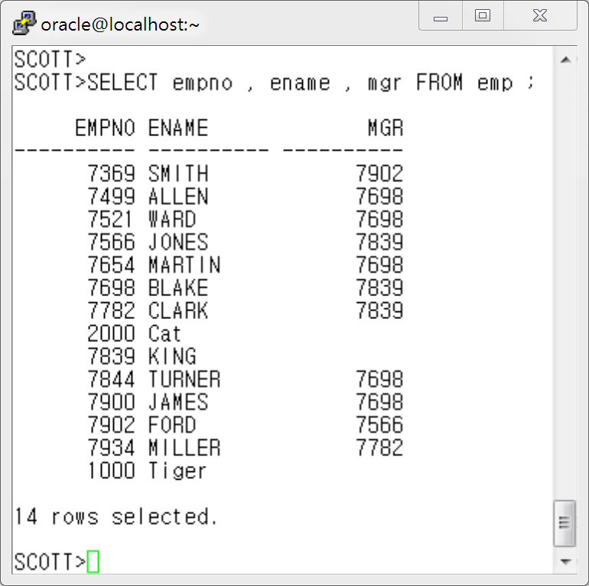
5. SELF Join
참고 : 왼쪽 화면에서 1000 번 Tiger 와 2000 번 cat 데이터는 저자가 그룹함수 장에서 연습문제를 위해 임의로 삽입한 데이터로 원본에는 없는 데이터 입니다.

Slide 21
5.SELF Join
사원 이름 조회
상사 이름 조회

Slide 22
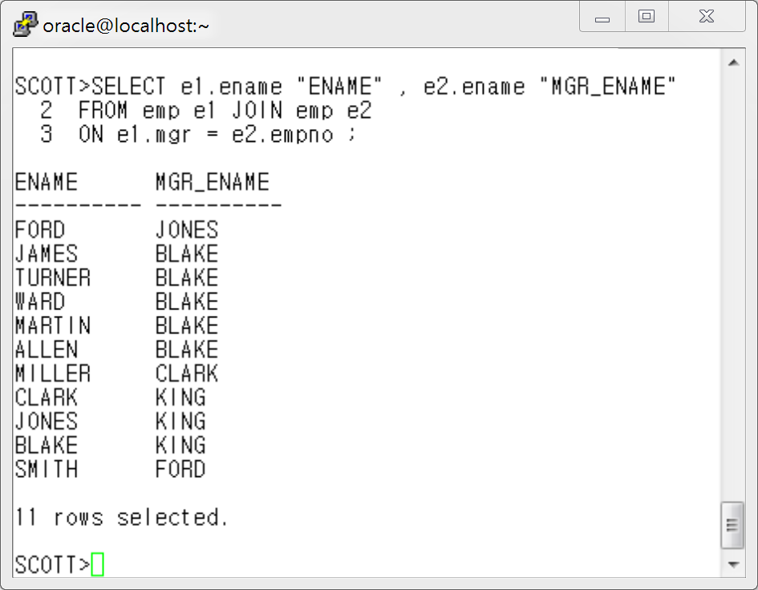
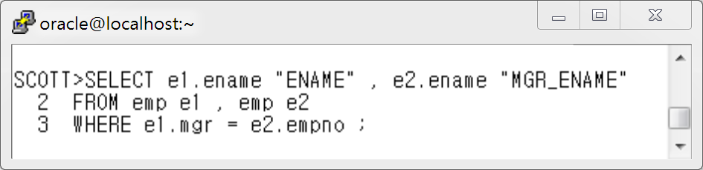
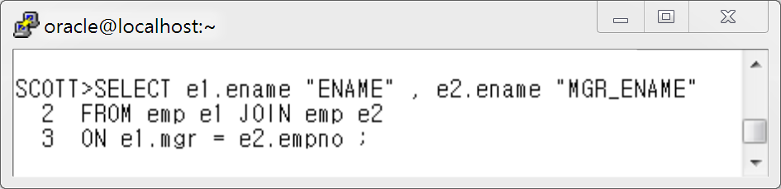
Oracle Join 문법
ANSI Join 문법

Slide 23
[ Check Your Self !! ]
1. 나는 Join 의 원리를 정확하게 이해하고 설명할 수 있는가? --------------------( YES / NO )
2. 나는 Oracle Join 문법과 ANSI Join 문법을 잘 사용할 수 있는가? --------------( YES / NO )
3. 나는 카티션 곱을 정확히 이해하고 사용할 수 있는가? --------------------------( YES / NO )
4. 나는 Equi-Join 을 잘 활용할 수 있는가? ------------------------------------------( YES / NO )
5. 나는 Non -Equi Join 을 잘 활용할 수 있는가? ------------------------------------( YES / NO )
6. 나는 Inner Join 과 Outer Join 의 차이점을 설명할 수 있는가? ------------------( YES / NO )
7. 나는 OUTER Join 의 문제점을 정확히 알고 있는가? -----------------------------( YES / NO )
8. 나는 Self Join 에 대해서 정확히 이해하고 사용할 수 있는가? -------------------( YES / NO )

